Slide 1
ITP172 Week 15 Final Presentation
CS1804 Team 3
Leader: Bryan Member1 Bryan
Members: Member 2 Eric
Member 3 Sherwinn
Member 4 XiaoXin

Slide 2
Week
Define problems and knows & Don’t know
Week 2
Survey
Collating survey results
Week 3
Timeline
Brainstorming of ideas
Week 4
Preparation of phase 1
presentation.
Week 5
Prototype and website development
Week 6
Financial Planning
Week 7
Marketing plan
Week 8
Week 9
Touch up on business plan
Business Pitch

Slide 3
Week 9
Business Pitch
Week 10
Term break
Week 11
Timeline
Term break
Week 12
Network design
Week 13
Self directed learning
Week 14
Technical review
Week 15
Presentation

Slide 4


What inspire us
We have seen many elderly or young kids who just started learning how to use computer,
when they encounter problems first they don’t know who to ask and troubleshoot their problems.Also often they will go to dangerous sites or click something harmful.When the elderly need help with their new technology tools often their children are not free or unwilling to help them as the elderly often don’t understand what they mean thus we aim to solve this type of problems and create an all in all platform to solve all the possible problems that IT newbies will encounter, at the same time we have a basic anti-virus to prevent virus attack when the user misclick or enter a unsafe website.Thus, creating a win-win situation for both the elderly/people learning how to use IT and the one teaching them as our platform have provide convenience for both parties.

Slide 5
Things we know
We know that in the IT world there will be a lot of competitions.
We know that IT has a very wide range of things.
We know that in order to earn money people must use and like our product idea.
We know that we must attract and meet the needs of our audience.
We know that we may need more than 1 person to set up a business as we need people from different profession.
We know that we need to spend money to maintain our business.

Slide 6
Things we don’t know
We don’t know if there will be any investor willing to invest in our business.
We don’t know if IT can bond with what other business in real life.
We don’t know what are the set back we will face if we were to set up an online business.
We don’t know what are the price to be set on our idea.
We don’t know who will be our target audience.
We don’t know what is attracting people’s attention.

Slide 7
Objective and Goals ( Summary Key Points)
-->New user often encounter problems when their started using computer .
-->They do not how to solve their problems.
-->No where to get help.(Things in the internet maybe too complicated )
-->dangerous sites or click something harmful.
-->people around can’t/unwilling to help them
-->We create an all in all platform to solve all the possible problems

Slide 8

Business Model

Slide 9

Government Fundings
Technology Enterprise Commercialization
Scheme (TECS)
The TECS is a government grants Singapore to help entrepreneurs realize their technology-based ideas into promising businesses. The scheme assists them in growing their business past the seed stage and then, obtain funding from the third-parties to achieve targeted revenues and growth. The proposals for the grant are ranked solely based on the evaluation of technical idea and its commercial merits. The TECS is highly useful to the startups with strong technology Intellectual Property & business model.

Slide 10


Expectations of Funds
Advertisements—30 cents per click
Video advertisement(30 sec)—$7.60 per 1000 views
Premium antivirus services
Game Developers to putting their games onto our platform-$100 per game (30% cut on games sales)
Government funds for startups-TECS min $250,000
In game items-10% cut on item sold
User removing advertisement from platform
Place for virtual private networks companies to put their apps on our platform-20% cut of each copy sold
HelpDesk service charge $49/h

Slide 11
Government Fundings
Eligibility: Companies registered in Singapore for less than five years and searching for the breakthrough, IP-based, and commercially viable technological solutions.
How It Works: TECS is a two-tier startup funding Singapore grant. Proof of Concept at $250,000 & Proof of Value at $500,000.

Slide 12


Financial Plan
How are we going to achieve $500,000 in 3 years

Slide 13
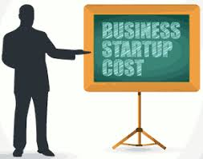
Starting Cost：Budget
Starting Fund- $250,000(Government funds)
Rental fees for rooms(warehouse):$15000/month
(3850sqft/358sqm)
Setting up a server fee :$100000
Employee fee:$5000 (for each employee)
Office equipment:$10000
Utilities bills:$1500/month
Advertisement fee:$10000(As we have social media influencer friend in instagram to publicize for us )
Interest from the bank:(6-7%of the loan every month)

Slide 14

Financial Summary
First Year:
Estimated revenue:$65 016++ (click advertisement)
Estimated Cost of total expenses:$250 000(Our expense for the first year is so huge because we need to pay for the setting fee for company)
Estimated loss:$184 984
Second Year:
Estimated revenue:$361 536
Estimated Cost of total expenses:$194 984
Estimated profit:$166 552
Third Year:
Estimated revenue:$926 436
Estimated Cost of total expenses:$10 000
Estimated profit:$916436

Slide 15

Why we are making more and more money each year?
As our company income is mostly earn through advertising, so throughout the year our company will have more and more user and thus the advertising company will pay us more and more.At the same time we also liaise with the advertising company and we help each other by doing each other the favour of promoting one another.

Slide 16



Competitions/Competitors
Games
Platform
Antivirus

Slide 17



Why are we different from our competitors?
HOW IS OUR SOLUTION DIFFERENT FROM THOSE EXISTING ONES?
Those company that being mention above are not perfect, they may not have all the features that meet all the expectations for customers convenience..
We decided to combine some features together

Slide 18
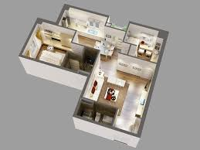
Prototype/Mockups

Slide 19
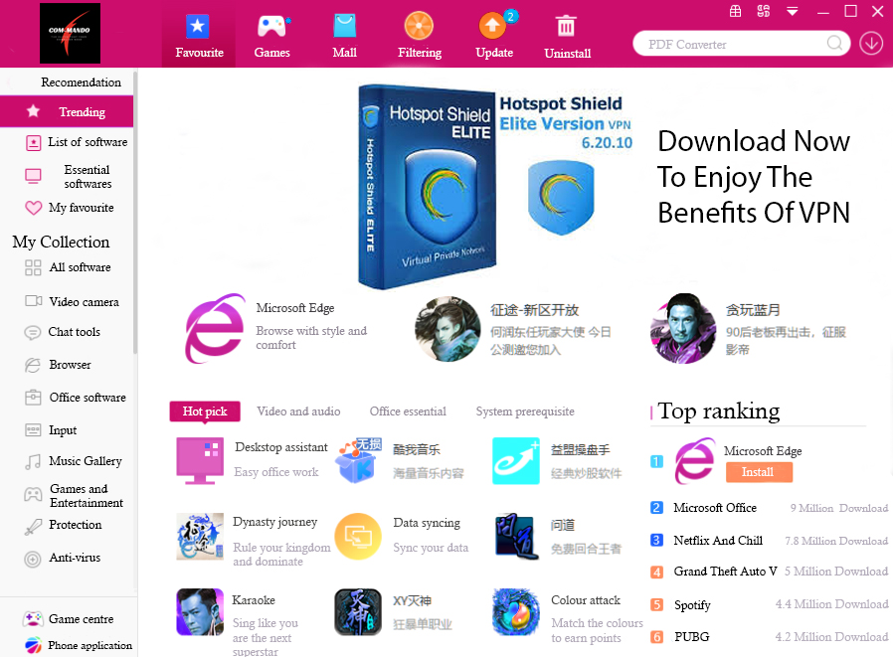

Slide 20
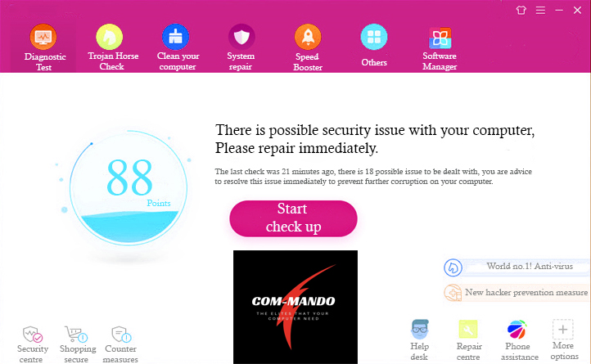

Slide 21
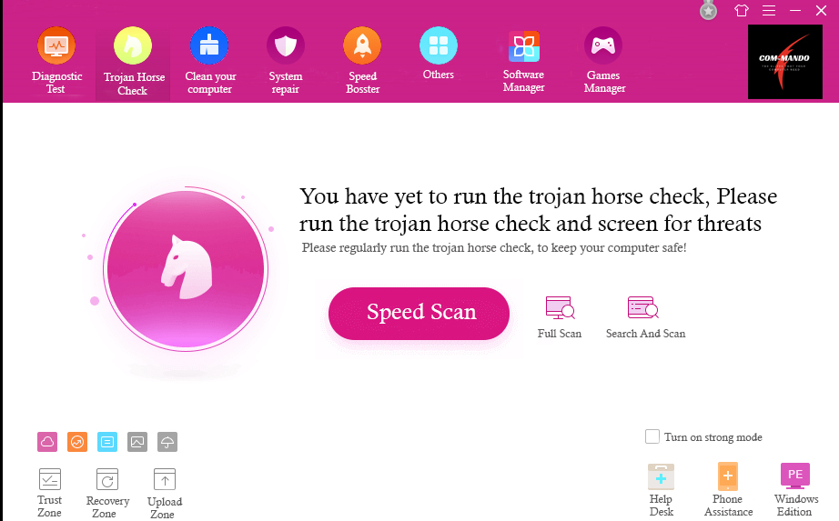

Slide 22
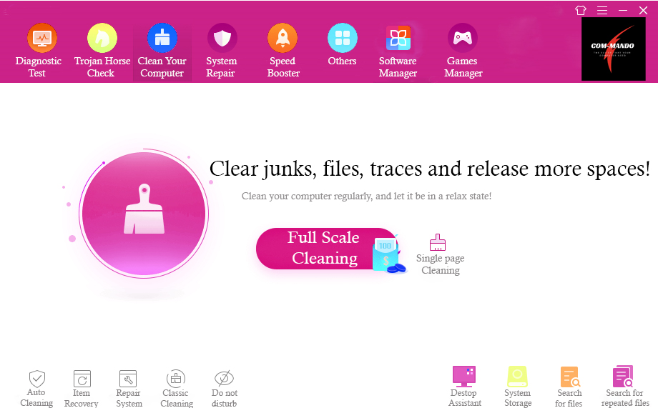

Slide 23
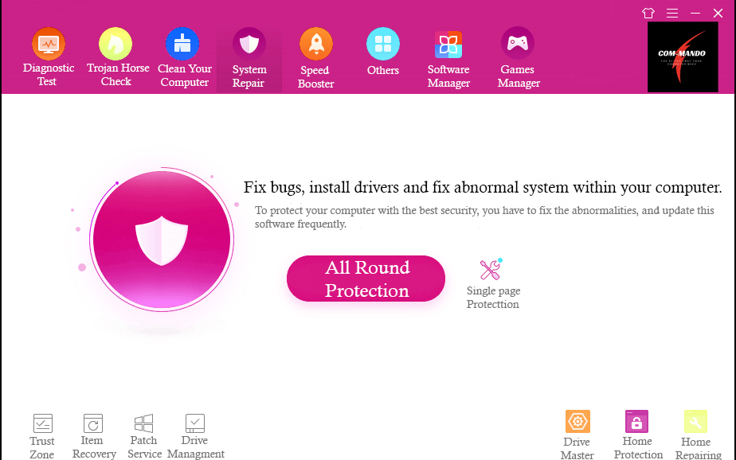

Slide 24
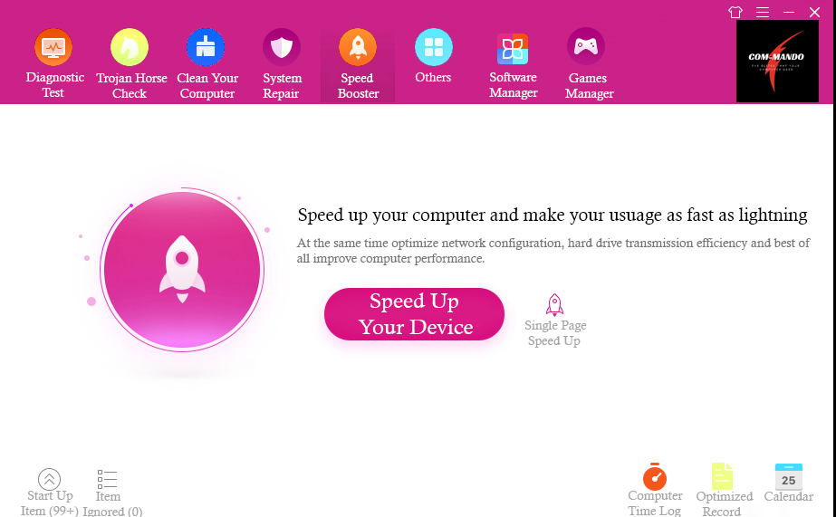

Slide 25

Our Successes

Slide 26
What have we done or achieved?
Com-mando founded in 2018
Participating in best innovative platform for convenience award 2018
Successfully planned our company future and budget
We have found a few companies who are interested in our platform.
Although what we have done are not much achievements but……..
Good attitude and strong level of competency
Right competency and mindset
Right mix of attitude

Slide 27
Why our company will be successful!
Based on our marketing research, people are very interested in convenience and security. Our platform exactly provides that, not only that this platform provided by us is totally free except for the premium services. It will be another big attraction to people. Hence, through this app we can gather a lot of user from the environment. Thus big advertising company will choose our platform and deploy advertisements,we can then earn money through every viewer and our company will have a lot of user thus, they can become our source of income. Making the sum of 500k after 3 years is not a dream but how much more we can make!

Slide 28
Reference
https://www.commercialguru.com.sg/listing/21529833/for-rent-cold-room-chiller-at-macpherson-ground-fl (For rental room)
https://ezbuy.sg/product/51000411684840.html?gclid=Cj0KCQiArqPgBRCRARIsAPwlHoWC6kQ8c1c9TmkonZ4moacujzGjEDTtPfu7wKWN0JQJjldBh56yQgMaAmmqEALw_wcB&gclsrc=aw.dshttps://ezbuy.sg/product/51000411684840.html?gclid=Cj0KCQiArqPgBRCRARIsAPwlHoWC6kQ8c1c9TmkonZ4moacujzGjEDTtPfu7wKWN0JQJjldBh56yQgMaAmmqEALw_wcB&gclsrc=aw.ds

Slide 29

Thank You!!

